Slide 1
Workout Memory Game
A challenge for the mind A challenge for the body

Slide 2
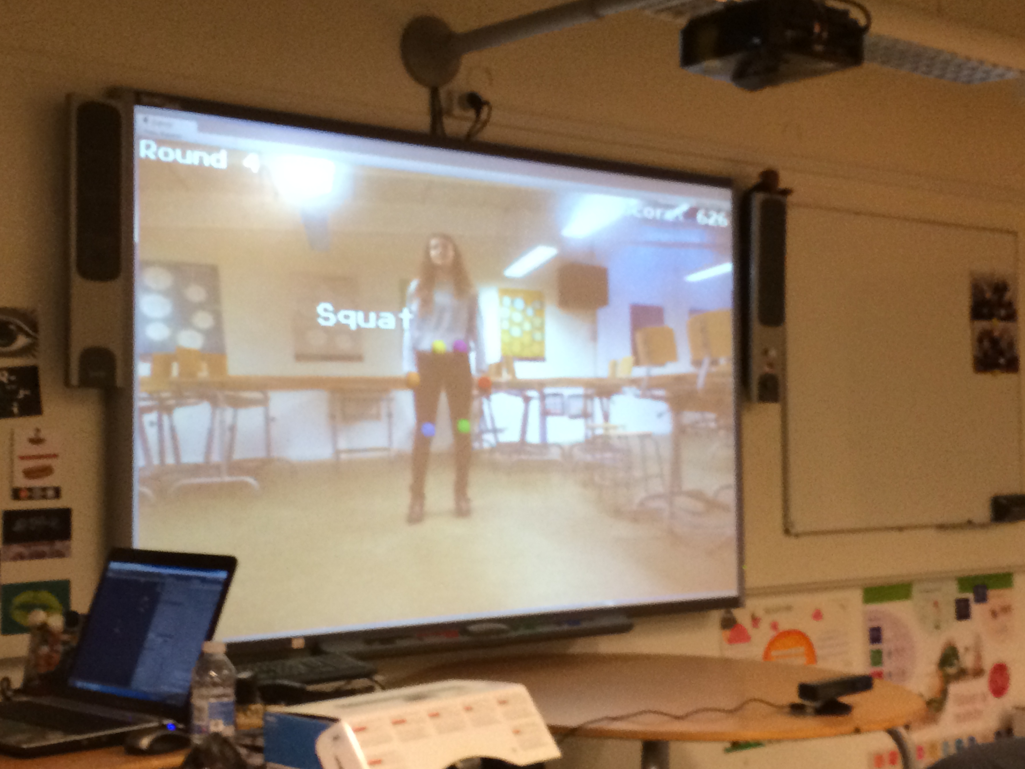
Game description
Round based
Exercises
Timing
Scoring
Game over

Slide 3
Implementation
Kinect integration
Joint tracking
Gesture recognition

Slide 4
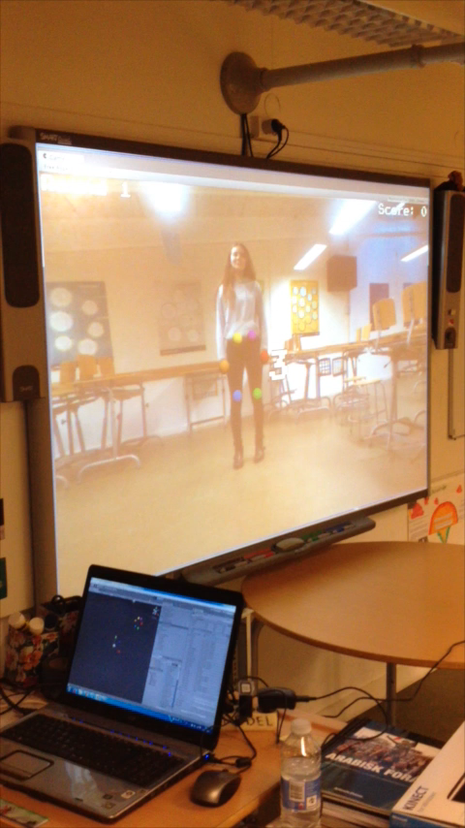
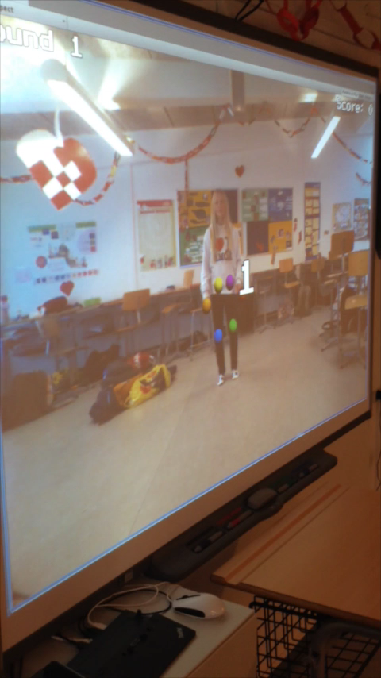
Demonstration

Slide 5
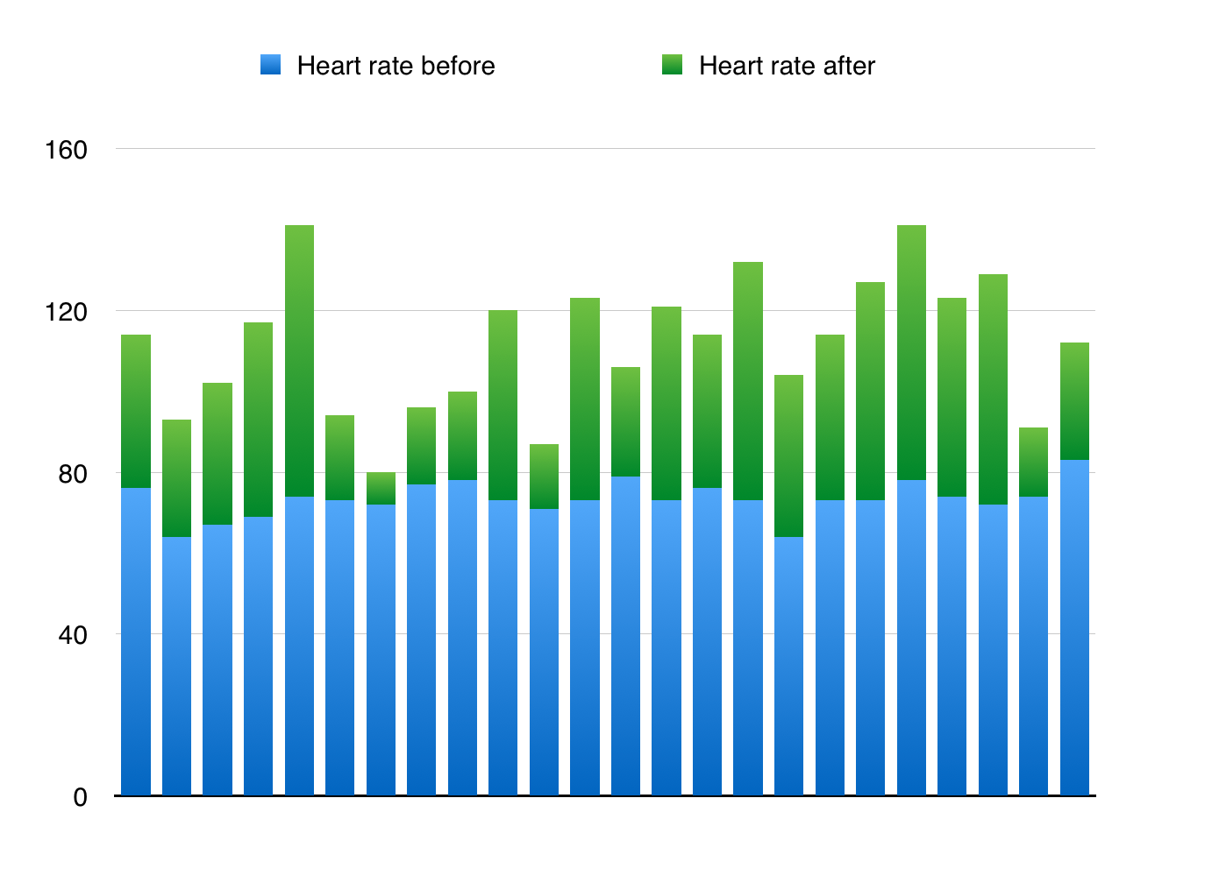
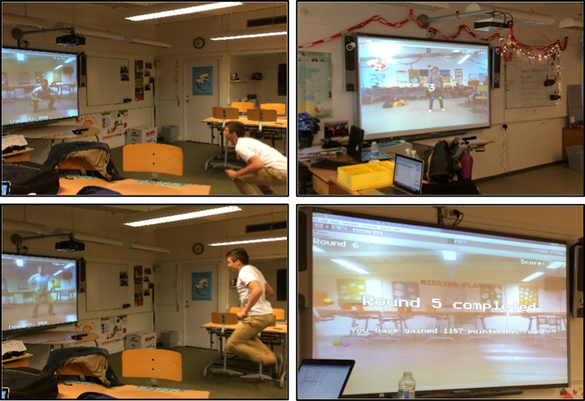
Test

Slide 6
Questions & comments

